Slide 1
Data-driven & Model-driven Methods and their use in computer vision
Xiaohao Cai
University of Southampton UK
COMP3204 Computer Vision
What are their pros and cons?
Credit Prof. Mark Nixon

Slide 2
Content
Biometrics account for a large portion
in computer vision
2. Some data-driven and model-driven methods
in computer vision

Slide 3
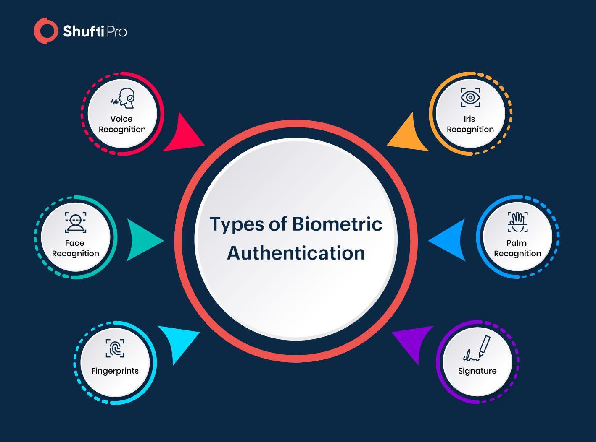

Slide 4
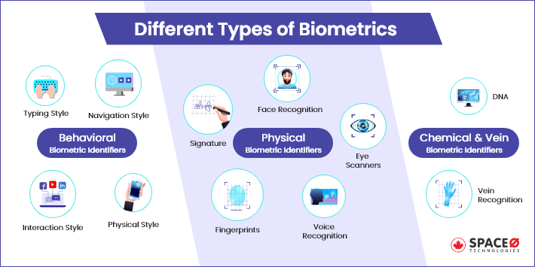
https://www.spaceo.ca/biometrics-authentication-types-technology-trends/

Slide 5
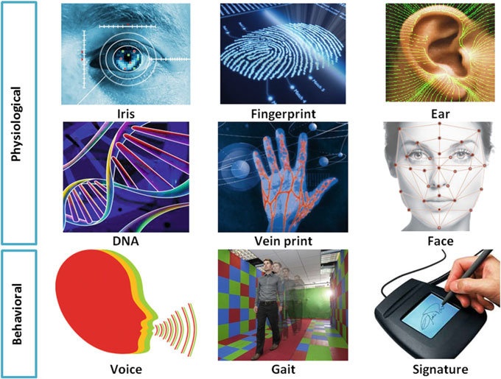

Slide 6
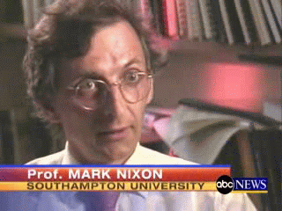
Gait biometrics
Identifying people
by their gait
As a biometric, gait is available at a distance when other biometrics are obscured or at too low resolution
ABC News, July 13 2006

Slide 7
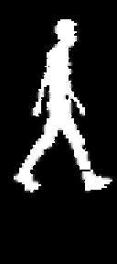
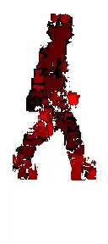
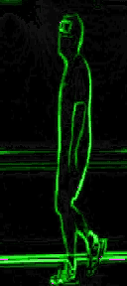
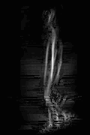
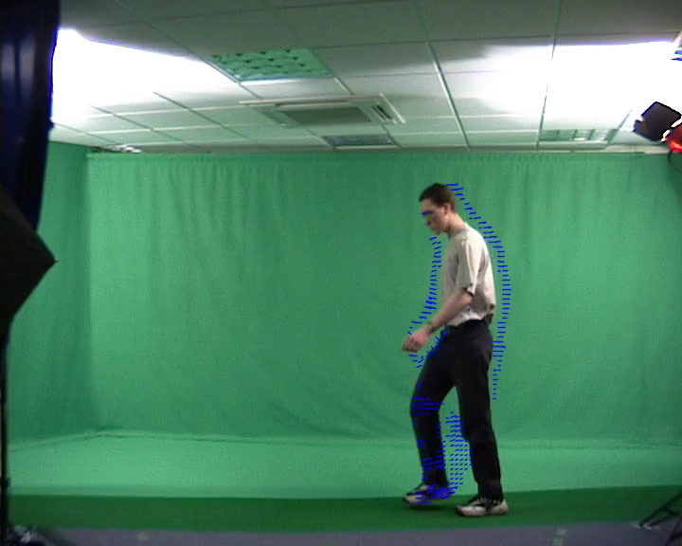
Many gait representations possible
Recognising people from the motion of the whole body
silhouette
flow
edges
symmetry
acceleration
MS Nixon, T Tan, R Chellappa, Springer, 2005

Slide 8
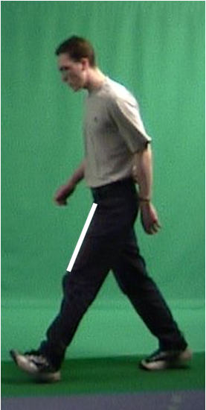
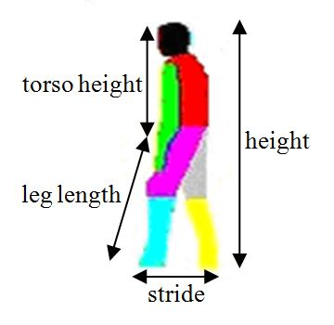
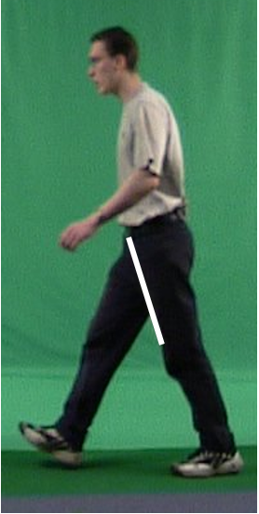
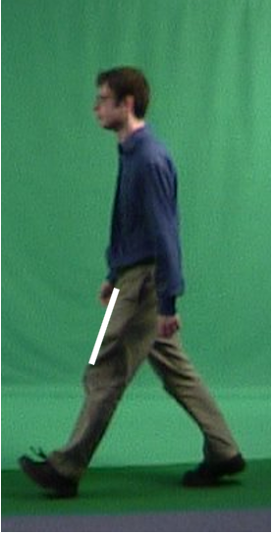
Model-based recognition
Inclination of thigh
Magnitude of DFT
Other models are possible
Difference between magnitude
Difference between phase
D Cunado, MS Nixon, JN Carter, Proc. AVBPA, 1997

Slide 9
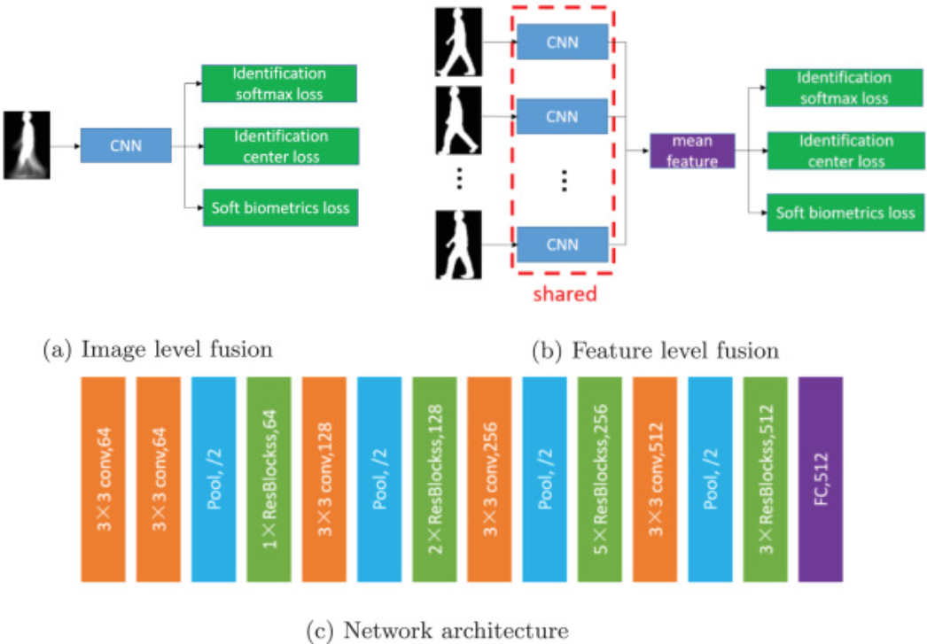
Hand crafted then; deep learning now
Y Zhang, Y Huang, L Wang, S Yu, Pattern Recognition, 2019

Slide 10
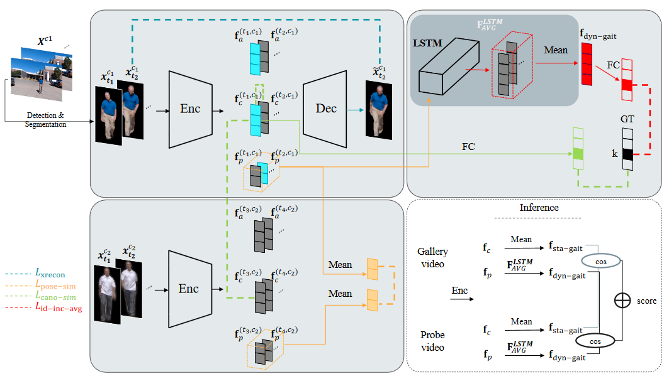
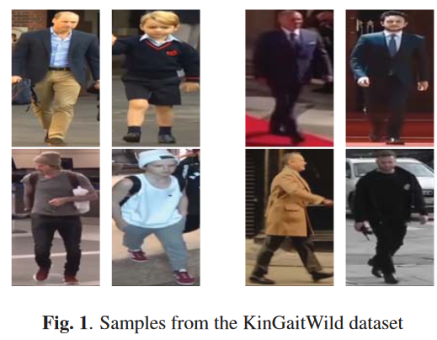
Recent works - Gait
SE Bekhouche, A Chergui, A Hadid…, ICIP 2020
Z Zhang, L Tran, F Liu , X Liu, IEEE TPAMI 2019

Slide 11
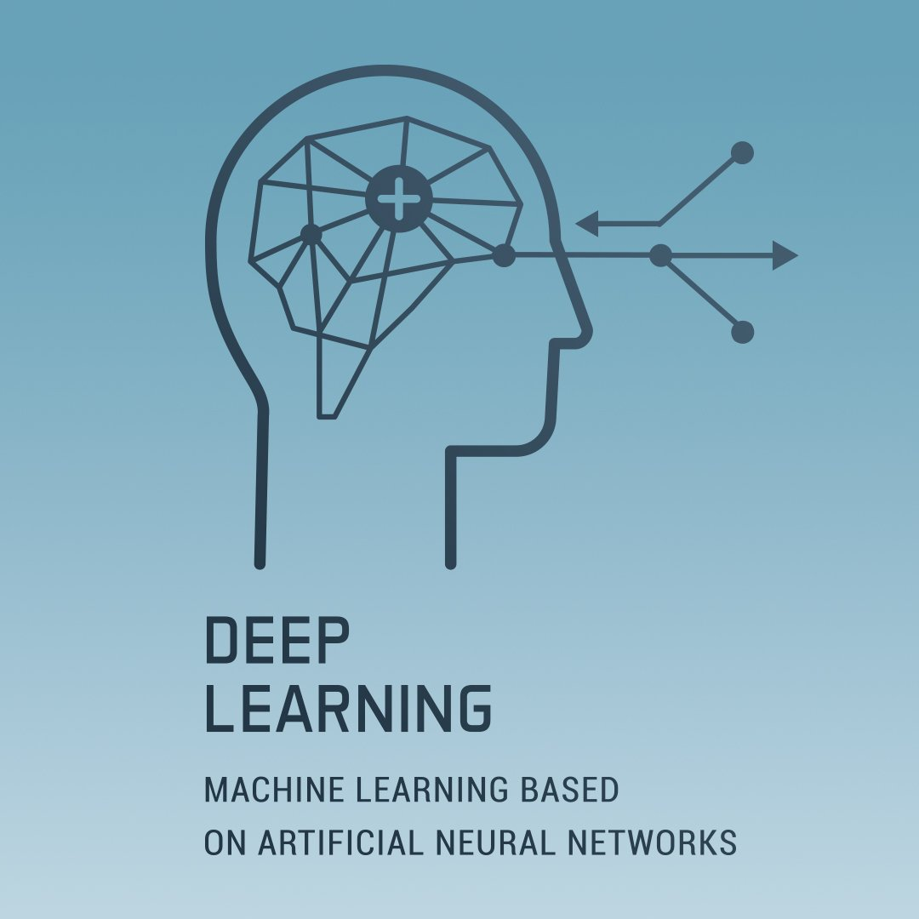
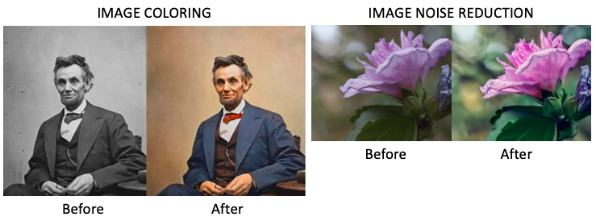
and many more …

Slide 12
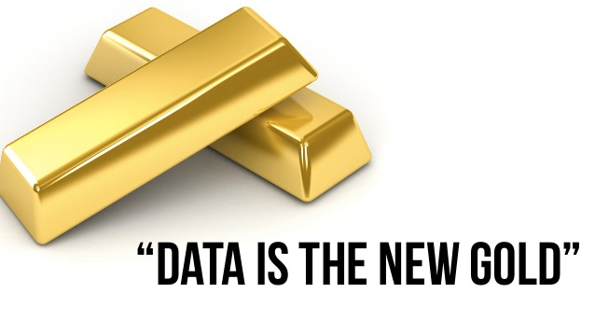
https://www.civilsdaily.com/burning-issue-data-the-new-gold/

Slide 13
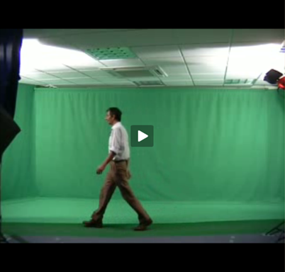
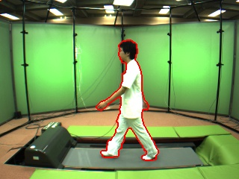
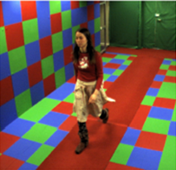
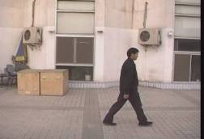
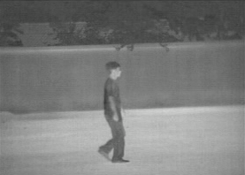
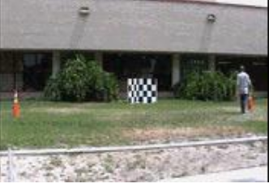
Gait biometrics databases
Laboratory
Southampton 3D and 2D
CASIA (+ multiview, thermal)
Osaka OU-ISIR (+ multiview)
‘Real’ World
HumanID
Southampton
CASIA
+ accelerometer, footfall, medical
M Okumura, Y Makihara, Y Yagi, IEEE TIFS 2012

Slide 14
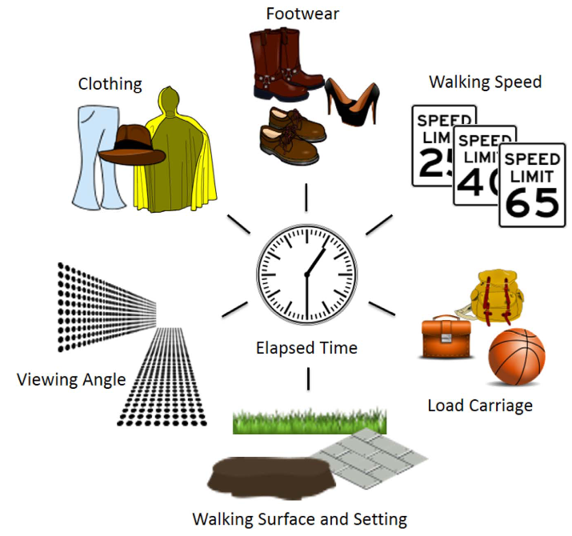
What changes regarding datasets?
Many covariates can affect walking style
…. + health, drugs, mood …
Domain shift
Class imbalance
Noisy annotation
and more …

Slide 15


Slide 16
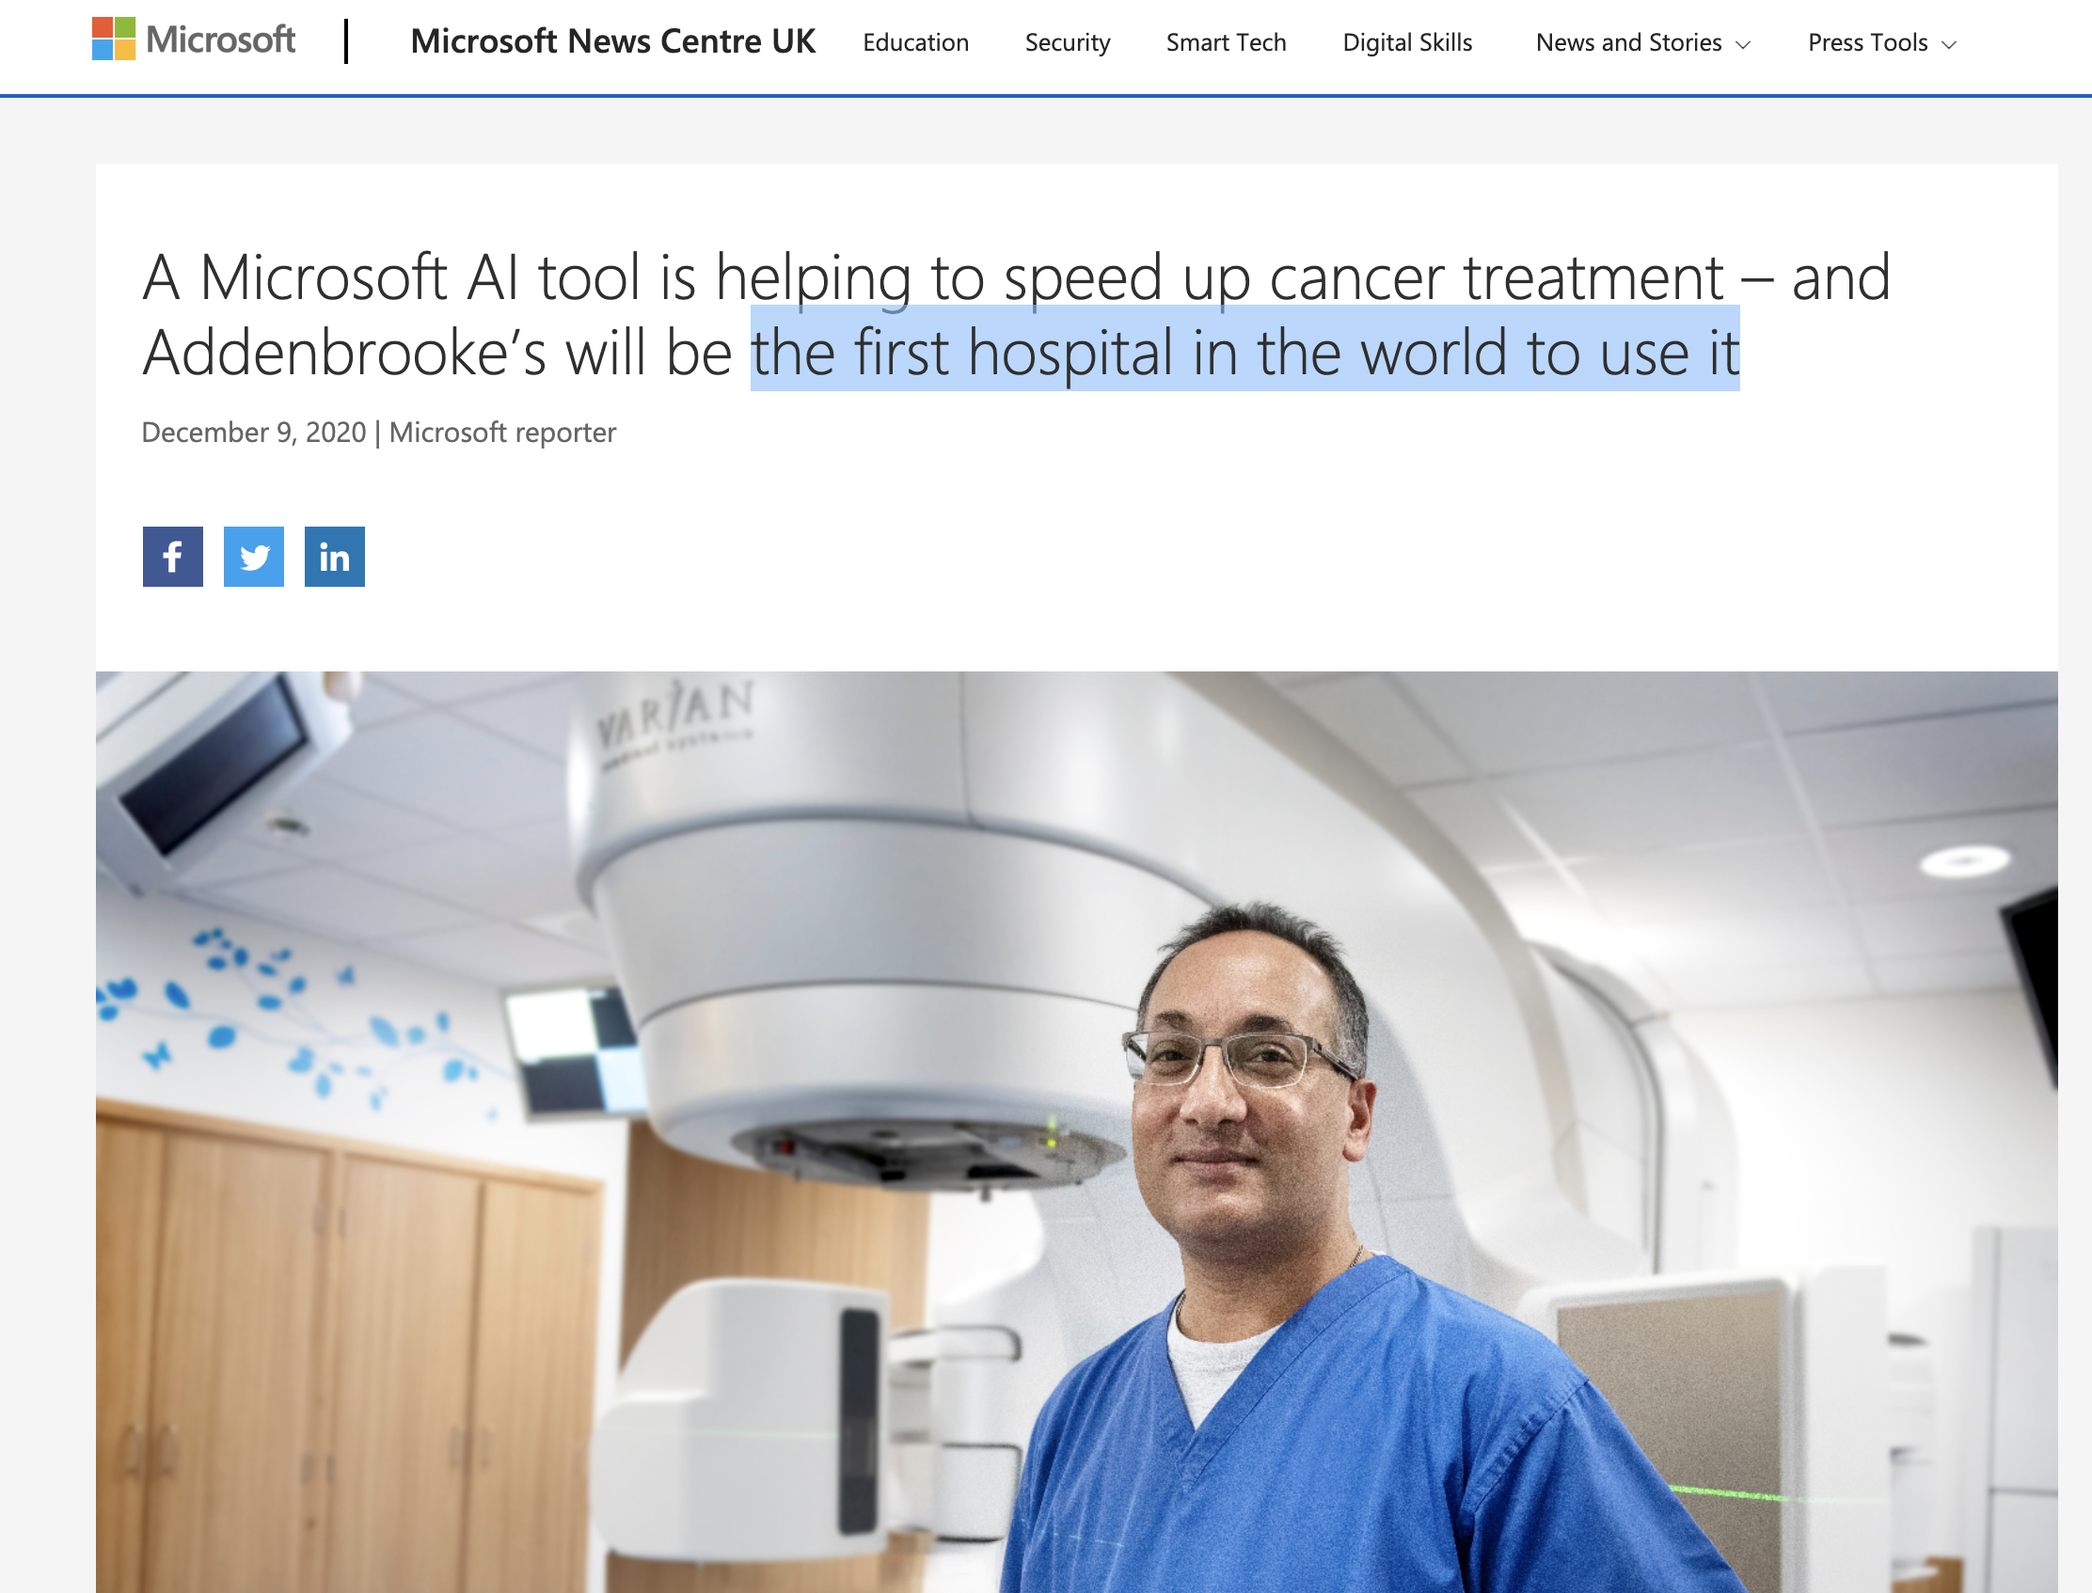
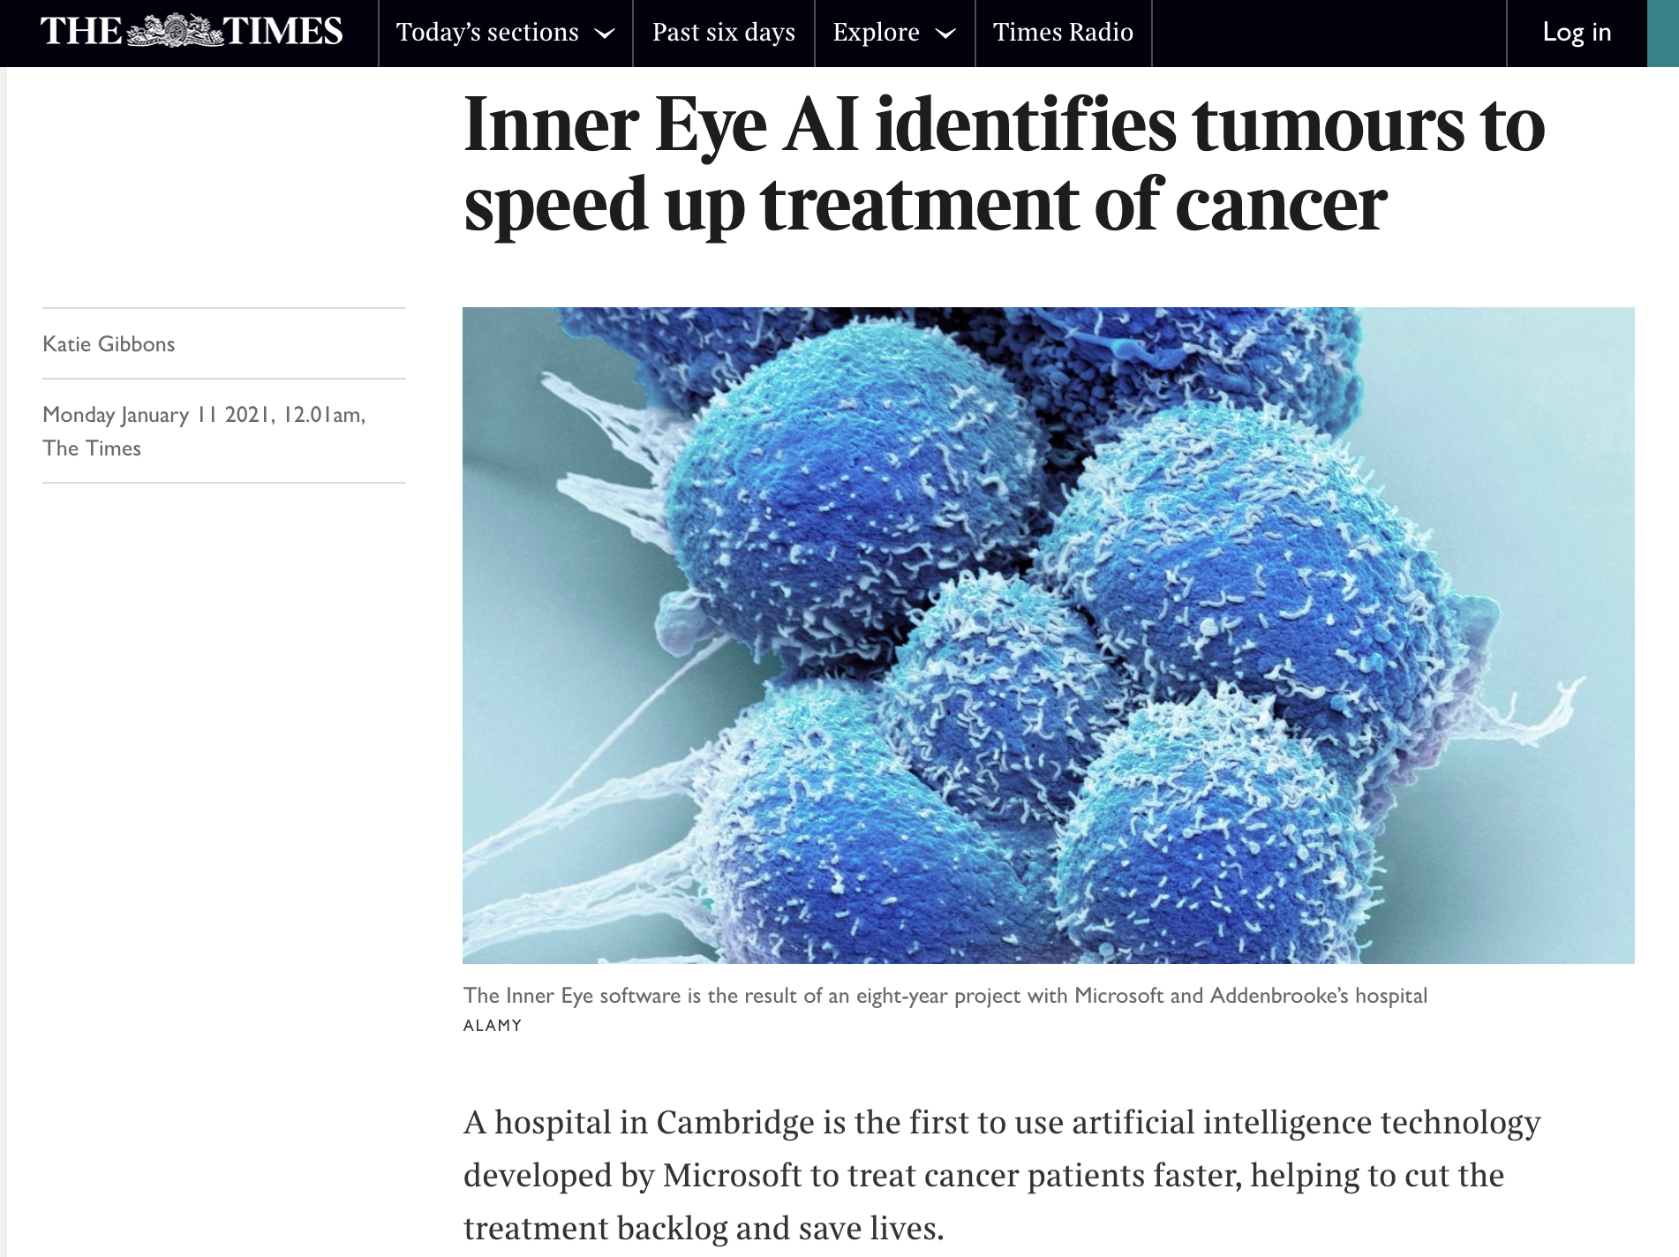
Medical imaging with AI
https://news.microsoft.com/en-gb/2020/12/09/a-microsoft-ai-tool-is-helping-to-speed-up-cancer-treatment-and-addenbrookes-will-be-the-first-hospital-in-the-world-to-use-it/

Slide 17
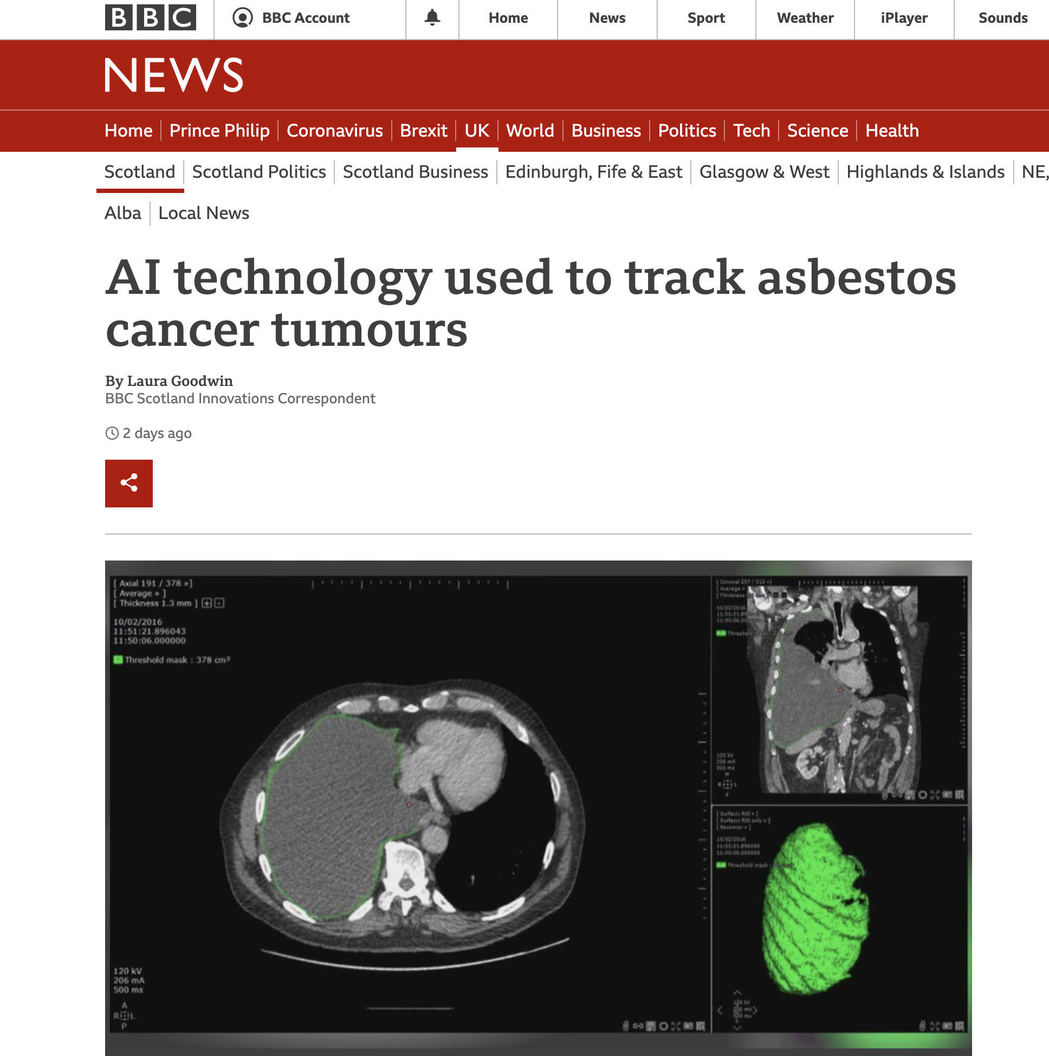
Medical imaging with AI
https://www.bbc.co.uk/news/uk-scotland-56734407

Slide 18
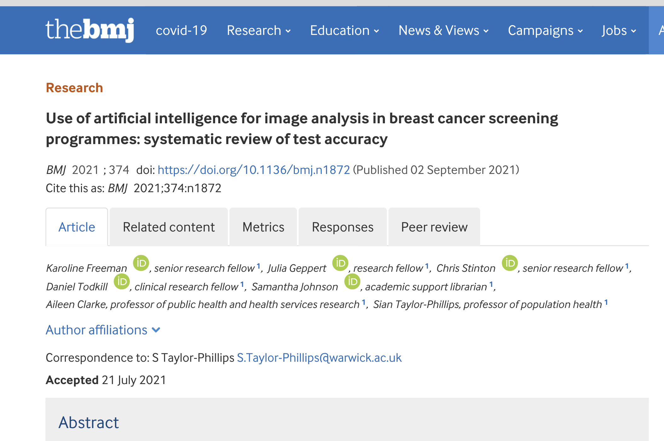
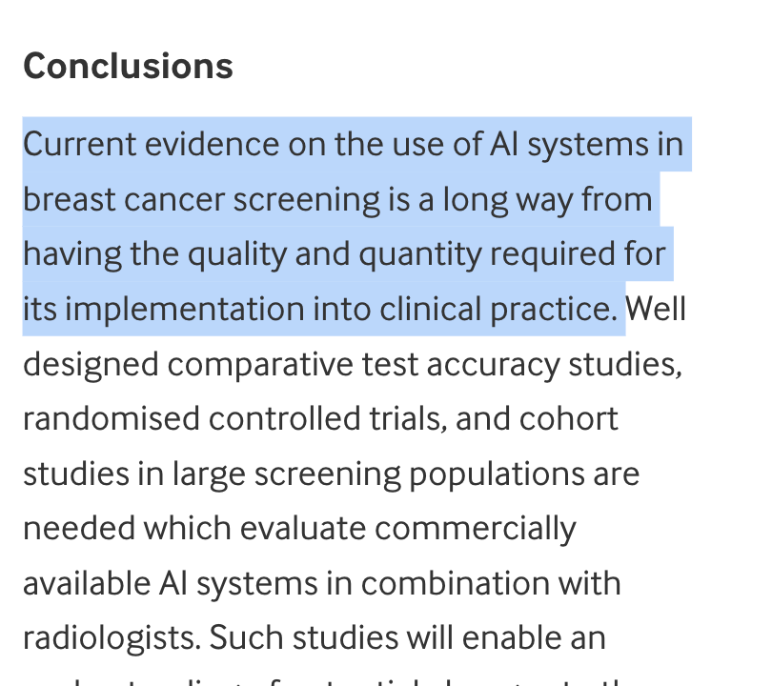
https://www.bmj.com/content/374/bmj.n1872

Slide 19
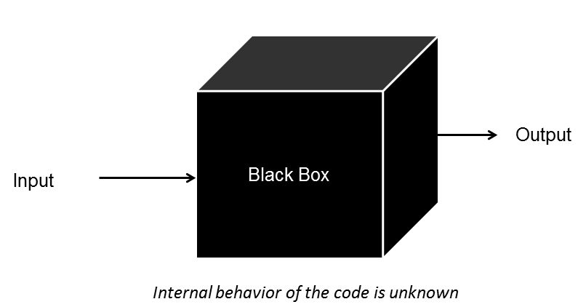

Slide 20
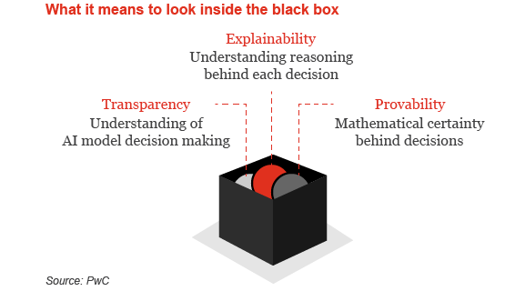

Slide 21
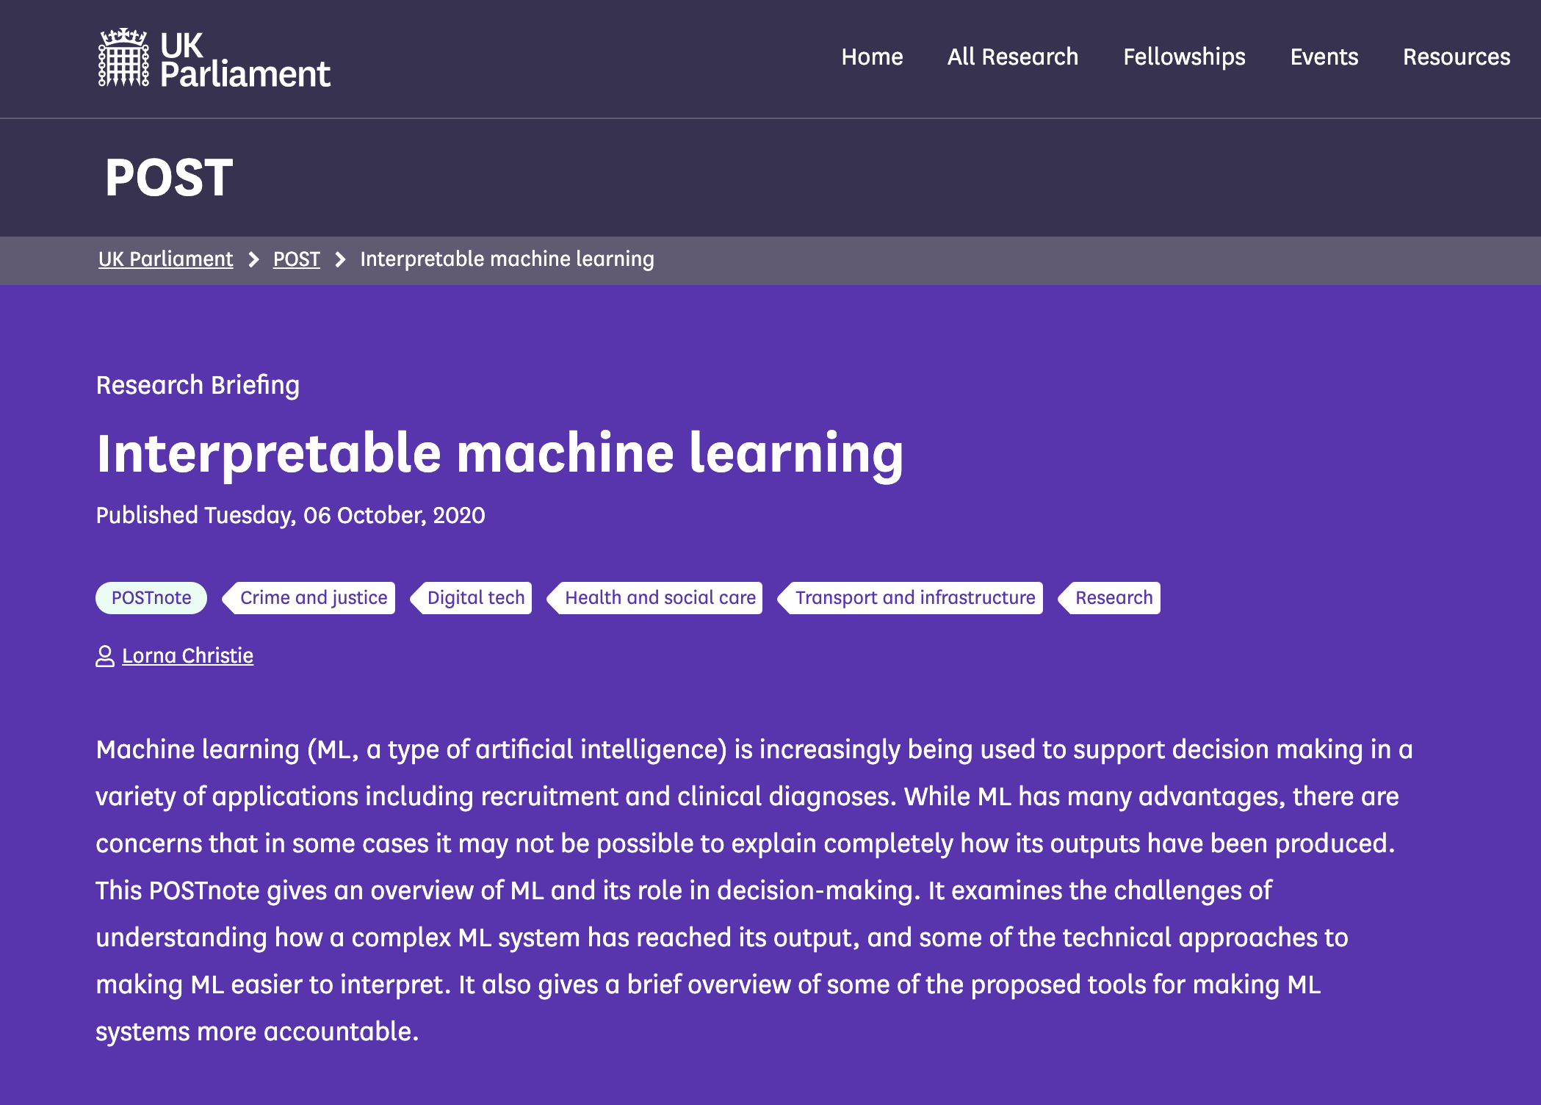
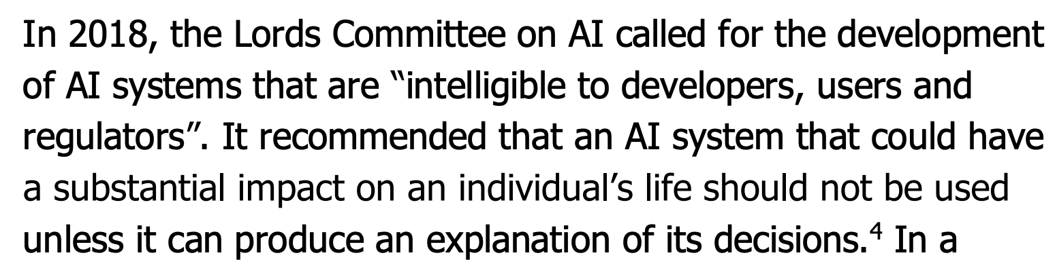

Slide 23
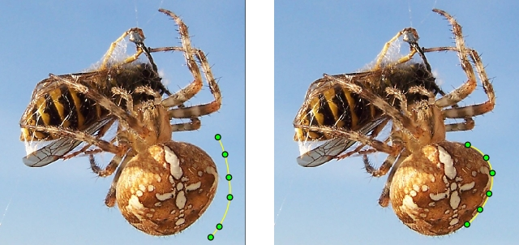
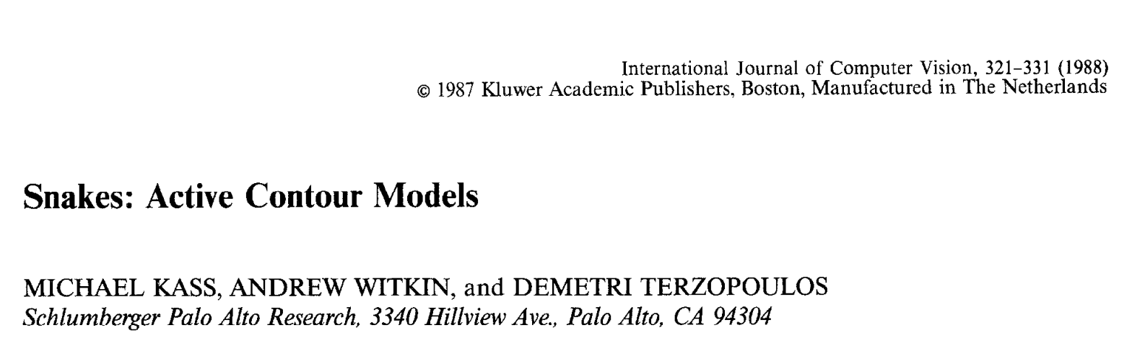
Active Contours
Model-driven
Methods
[credit: wikipedia]

Slide 24
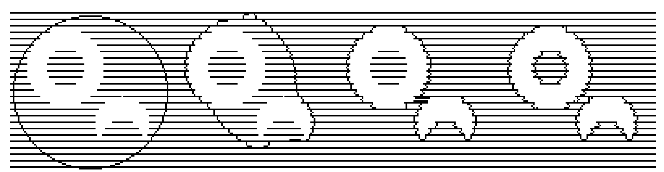
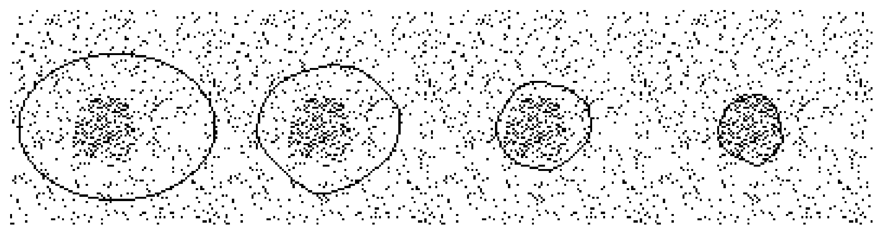
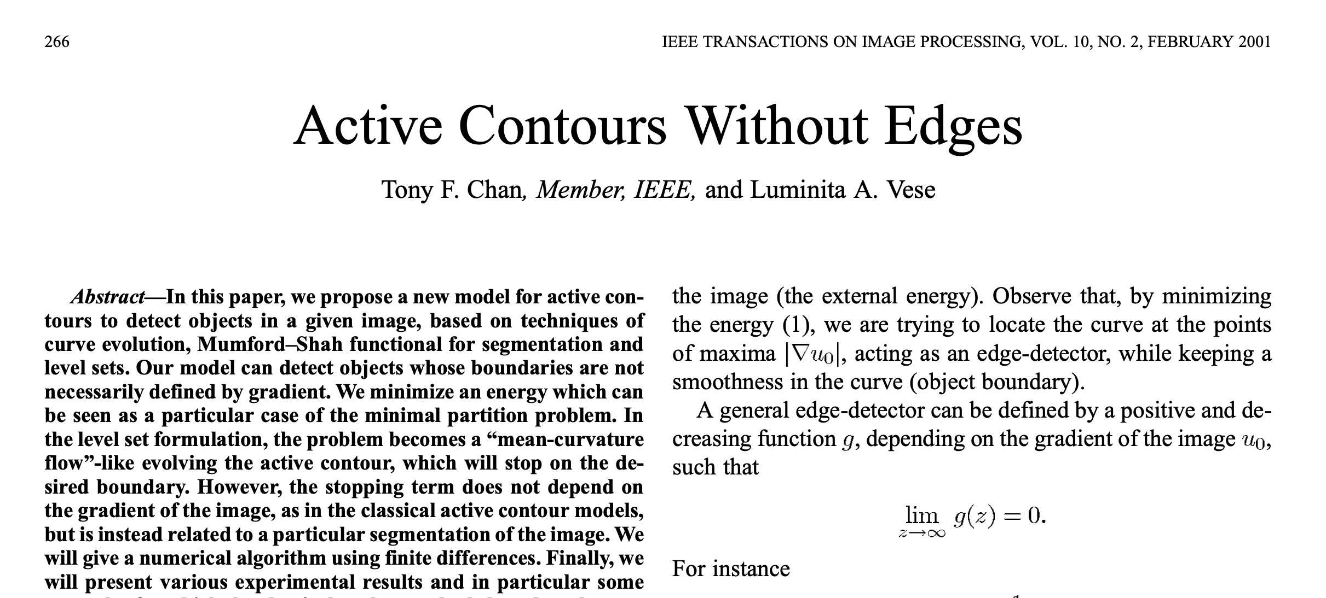

Slide 25
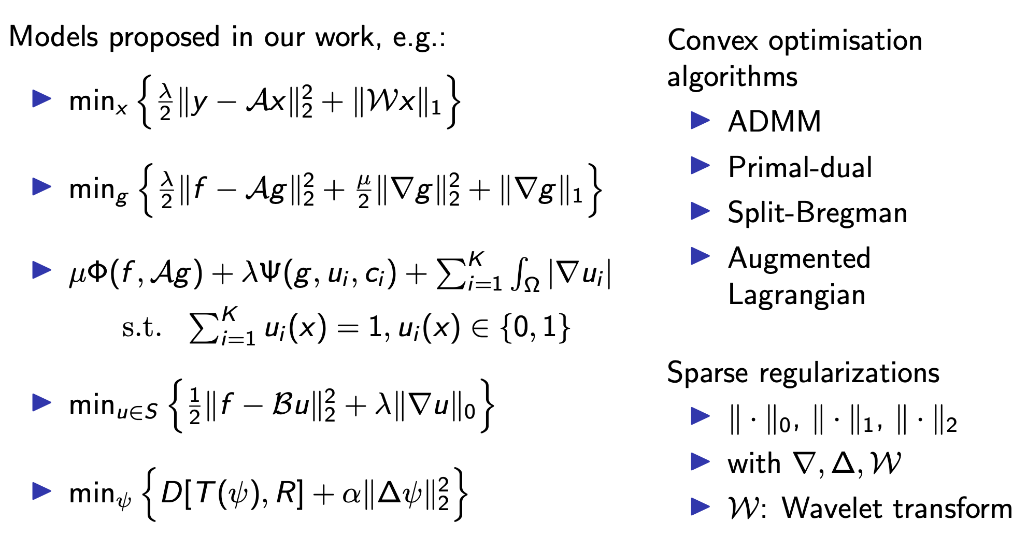
Models

Slide 26
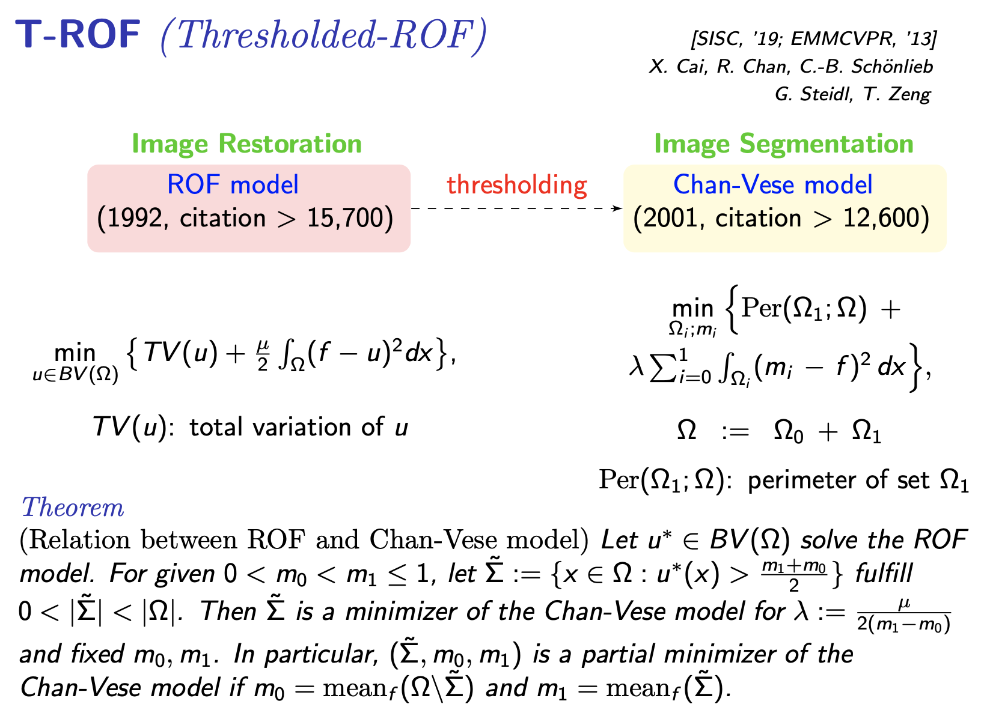

Slide 27
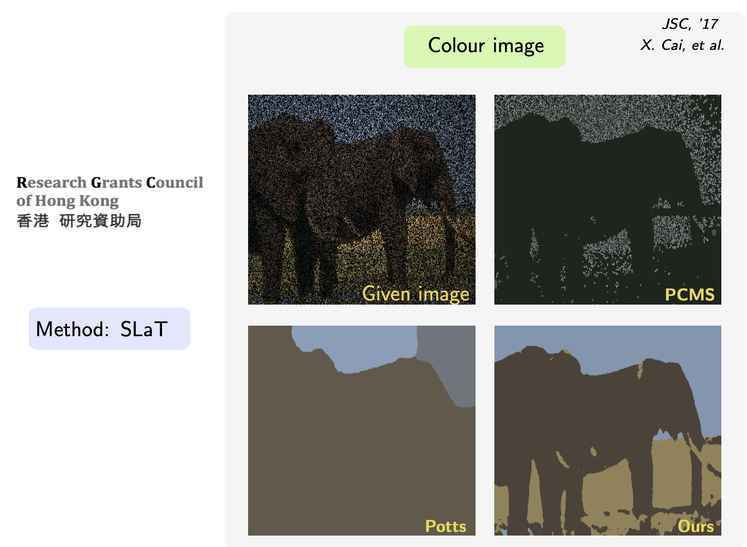

Slide 28
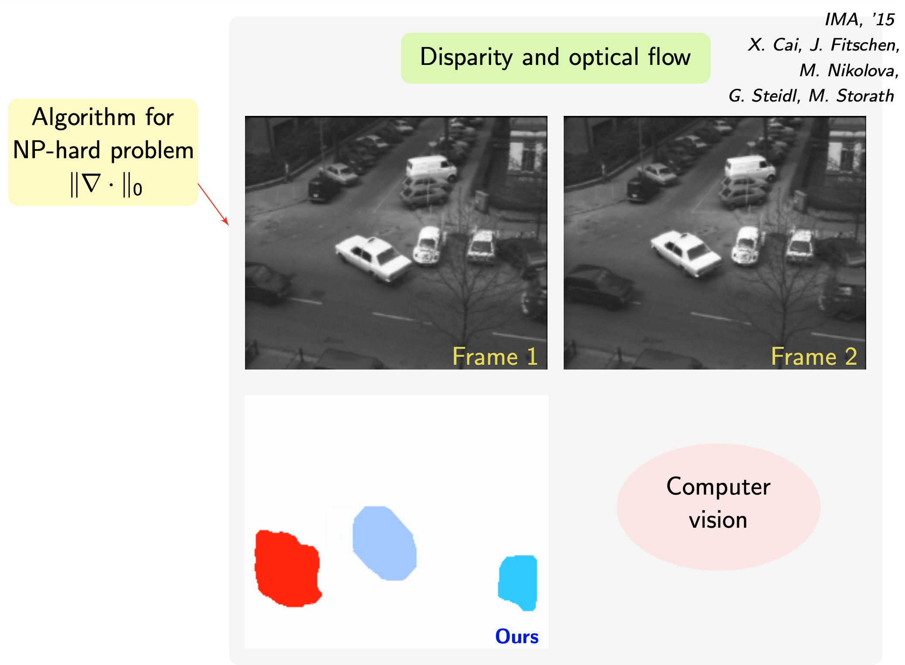

Slide 29
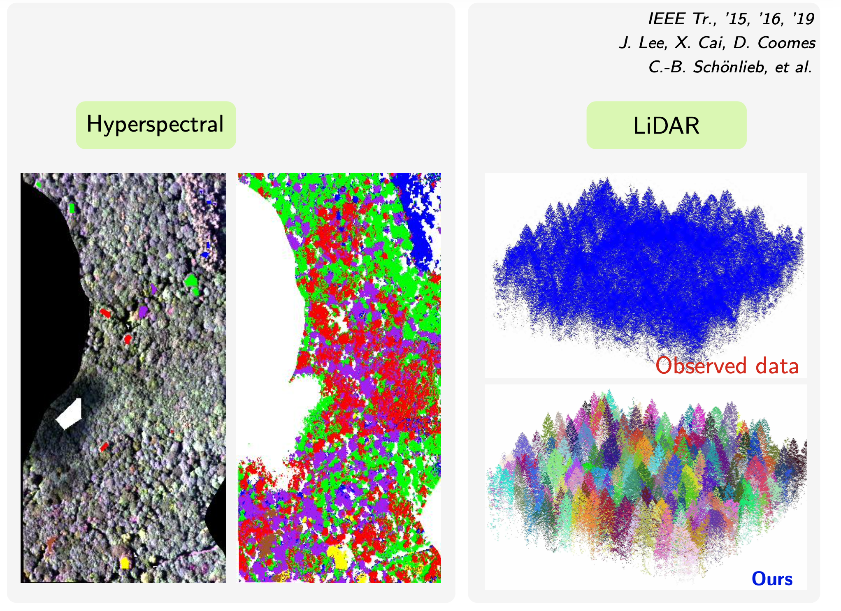

Slide 30
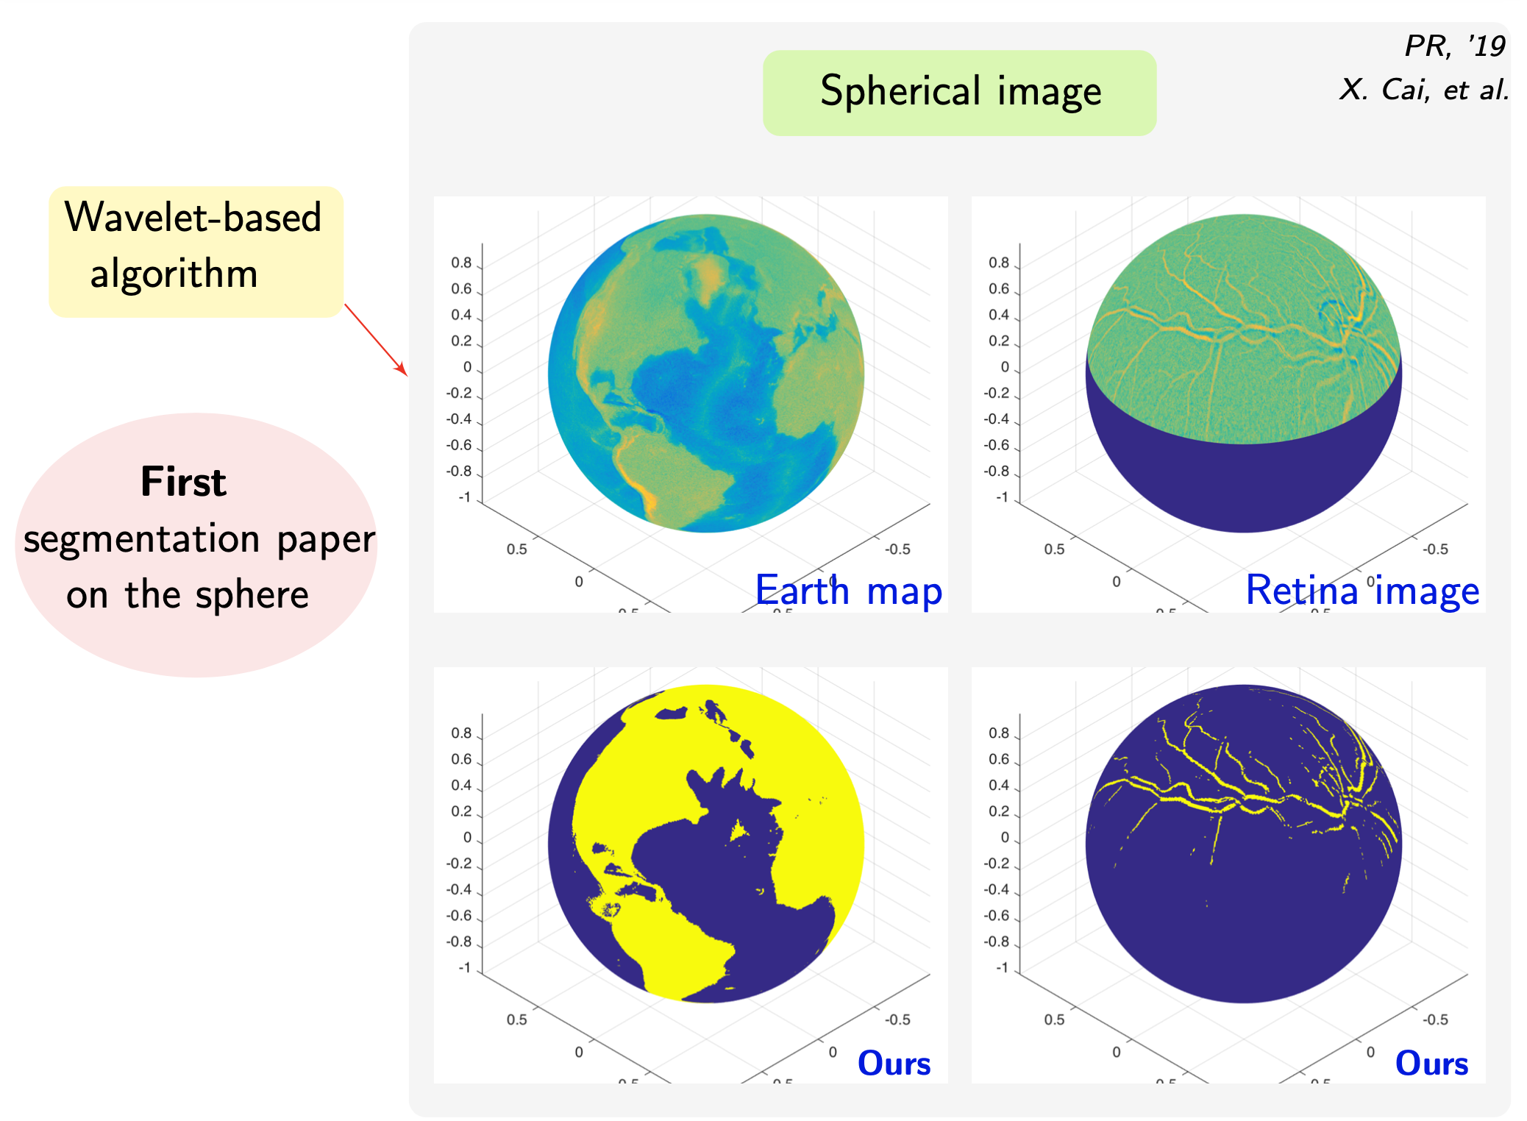

Slide 31
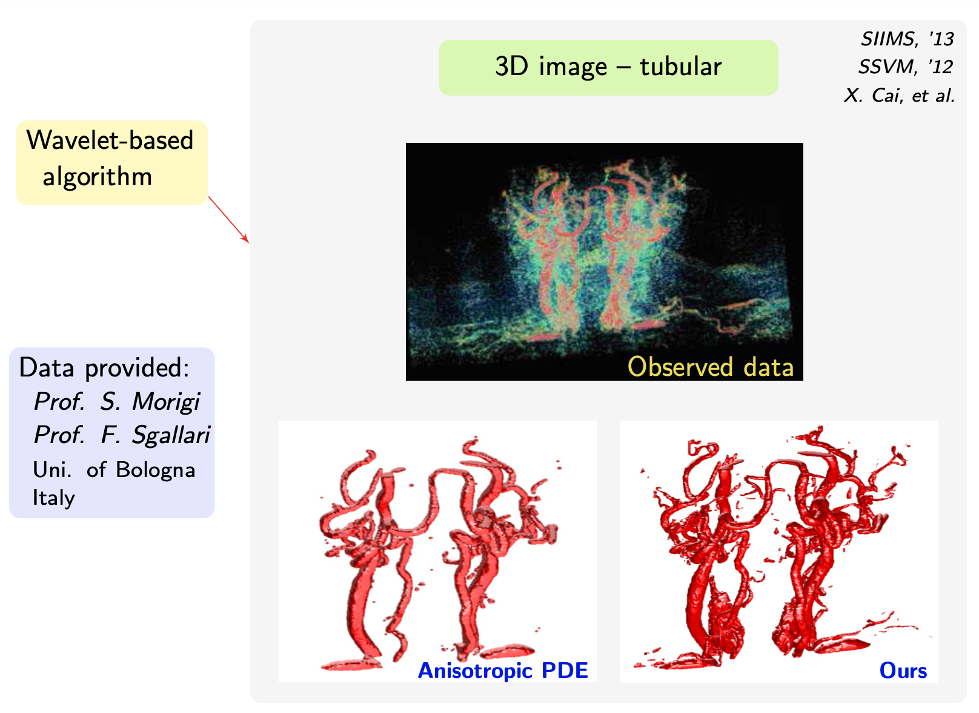

Slide 32
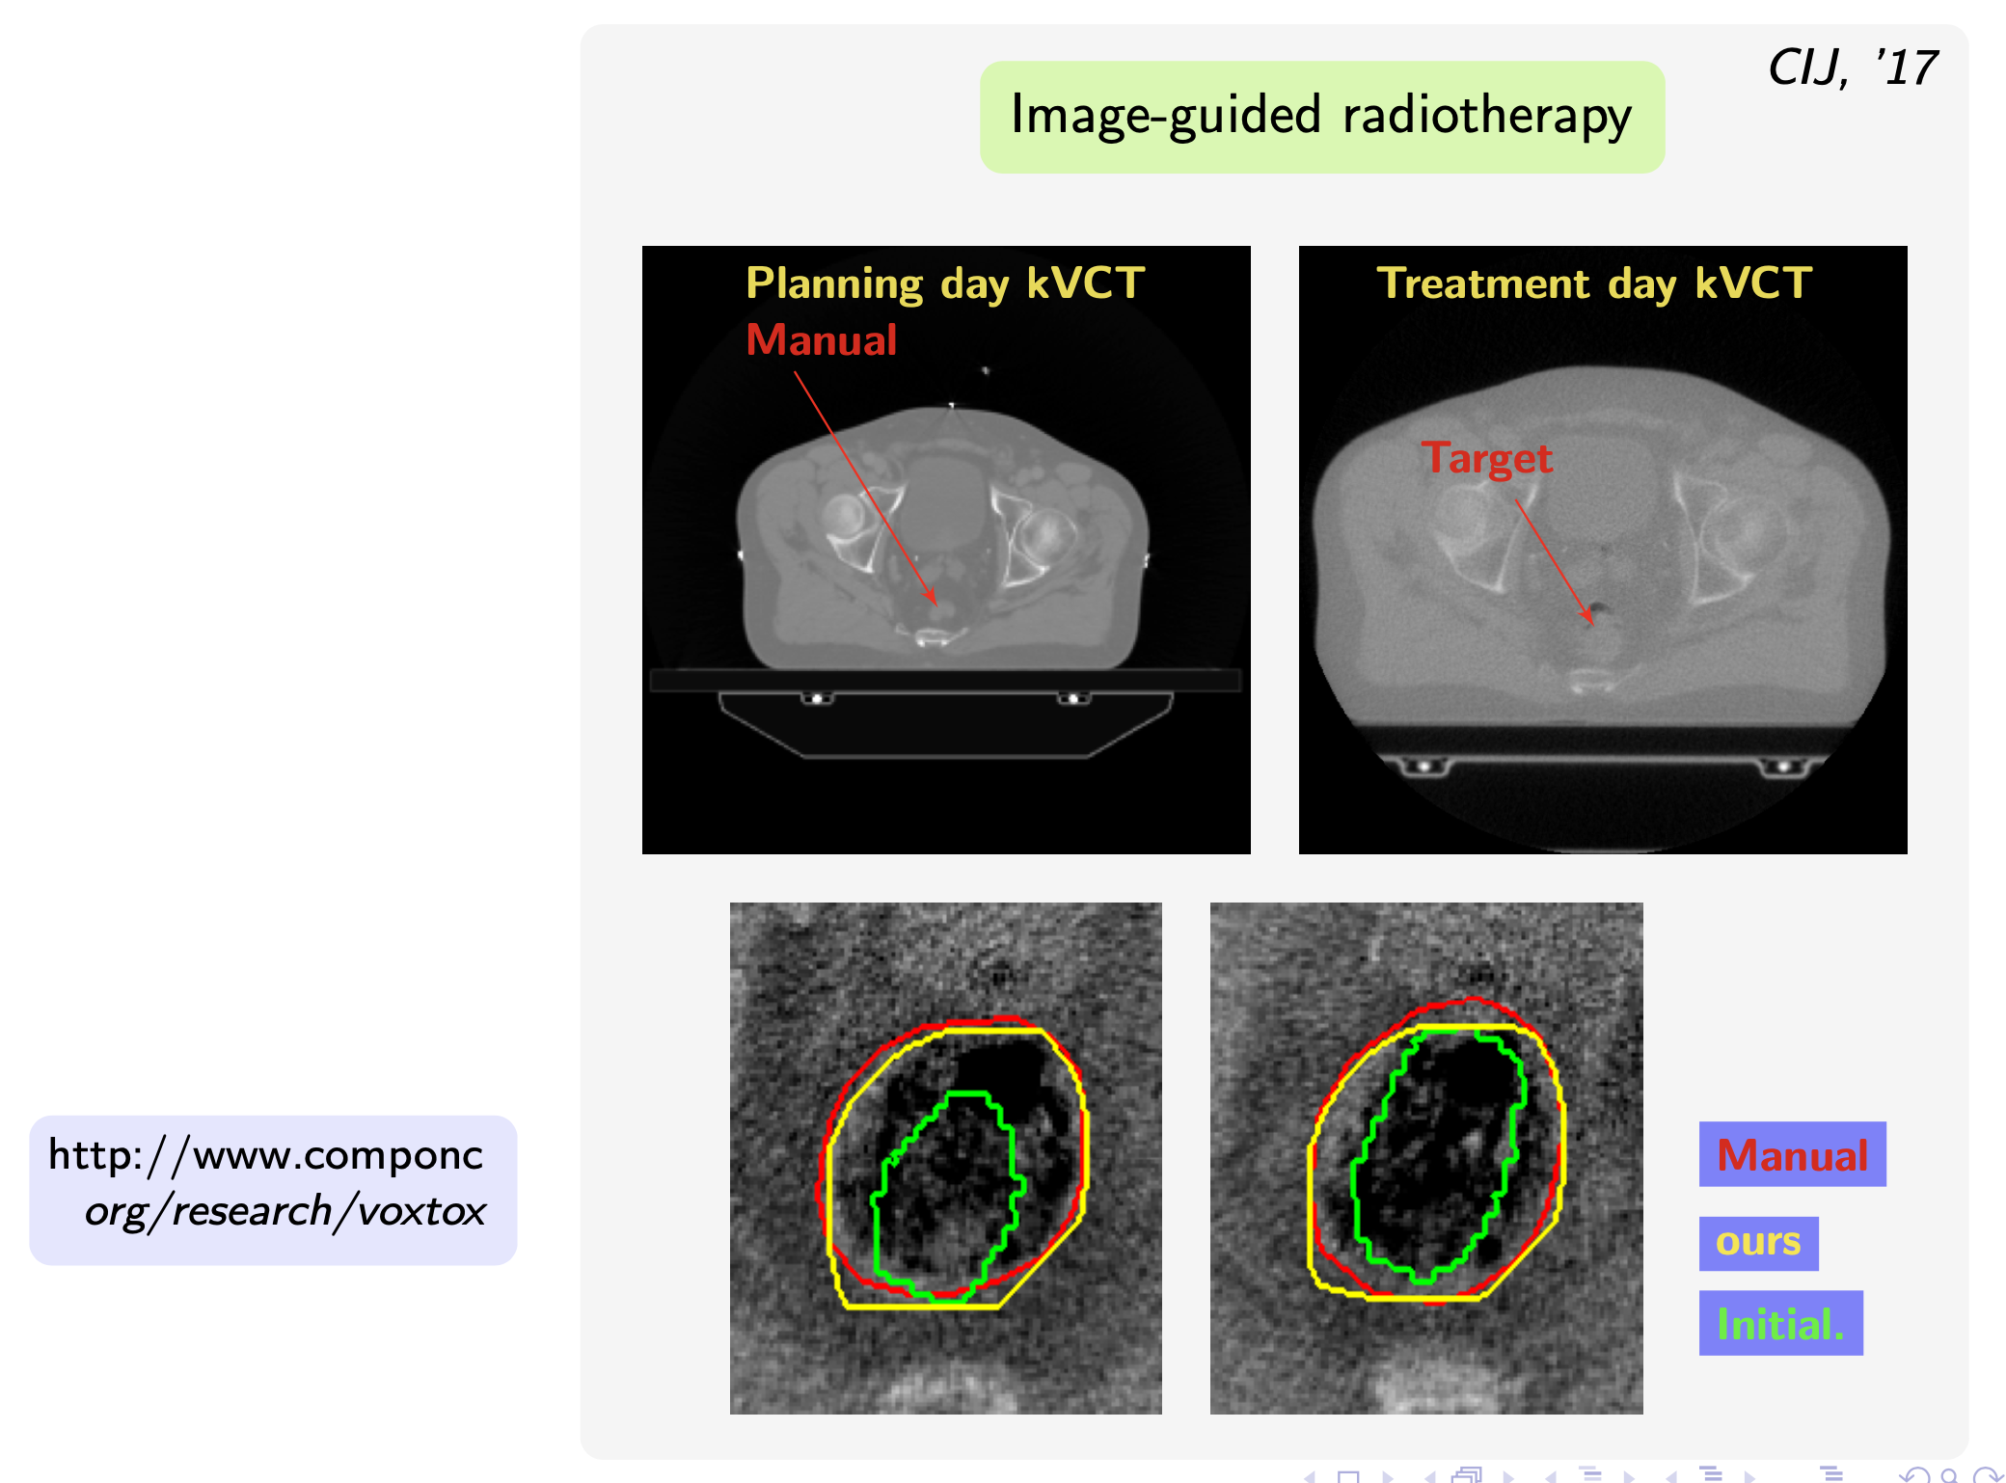
EUSIPCO, ’21

Slide 33
Recent: models leveraging deep learning

Slide 34
Conclusions
1. Computer vision works and has a great future
2. Big difference between data-driven and model-driven
3. Gap is becoming smaller
4. What will happen in the future?
We have more to learn …

